Slide 1
Applications of Electromagnetism: DC Motors

Slide 2
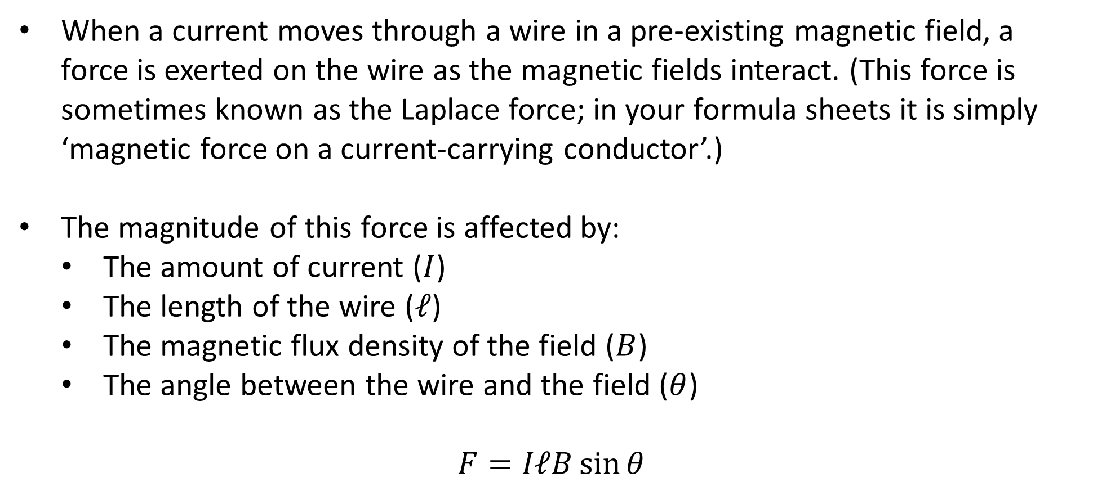
Review: Magnetic Force on Currents
When a current moves through a wire in a pre-existing magnetic field, a force is exerted on the wire as the magnetic fields interact. (This force is sometimes known as the Laplace force; in your formula sheets it is simply ‘magnetic force on a current-carrying conductor’.)
The magnitude of this force is affected by:
The amount of current ($I$)
The length of the wire ($ℓ$)
The magnetic flux density of the field ($B$)
The angle between the wire and the field ($θ$)
$$F=IℓB\sin{θ}$$
Notes:
Any charged particle moving through an electric and/or magnetic field experiences a force (known as the Lorentz force) based on the strengths of the fields. The force mentioned here is simply the sum of Lorentz forces on the electrons in a current-carrying conductor, ignoring the effects of any electric fields.
You may sometimes see this formula written as $F=BIL\sin{θ}$. As we’re about to see, this is somewhat unhelpful.

Slide 3
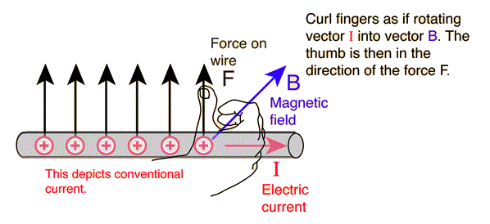

Review: Magnetic Force on Currents
Determining the direction of this force requires the use of the right hand rule again:
Helpfully, the equation ($F=IℓB\sin{θ}$) lists the two vectors in this order.
$$IℓB$$
$$I \text{to} B$$
Notes:
Make sure you’re using arrows that are coming out of the wire, not going into it!
Strictly speaking, the force is $F=Iℓ×B$: a cross product (vector product).

Slide 4
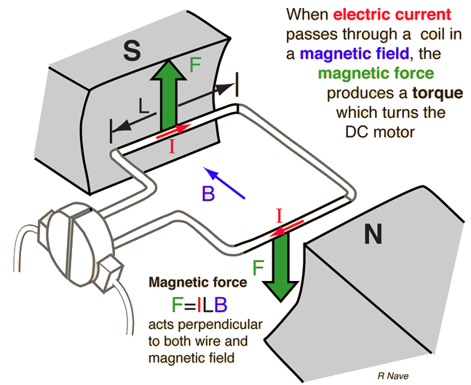
Motors
A motor is any device that transforms input energy into kinetic energy (i.e. the rotation of the motor shaft/axle).
For many motors, the input energy is chemical energy stored in fuel; for electric motors, it is electrical energy.
In an electric motor, a current is passed through a coil (a.k.a. armature) in a magnetic field, which applies opposite vertical forces to the two sides of the coil perpendicular to the field.
These forces produce a torque on the coil, causing the shaft to rotate as intended.
But things don’t work as intended for very long…

Slide 5
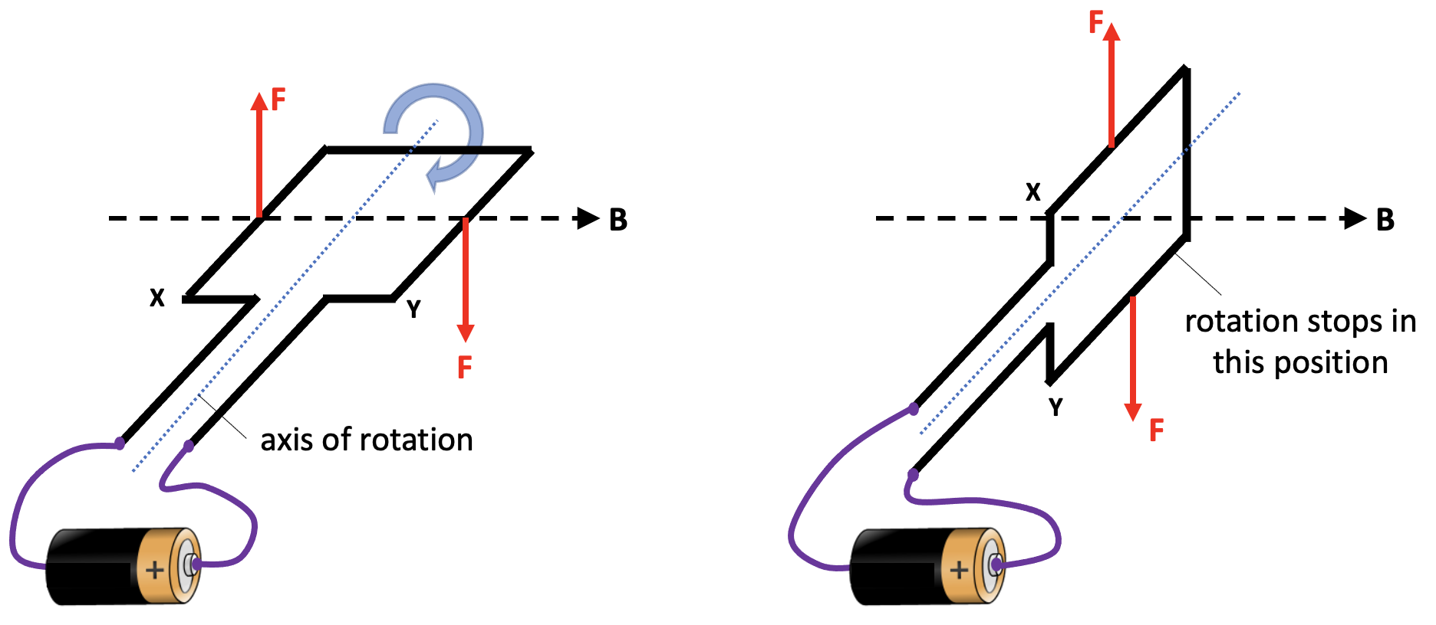
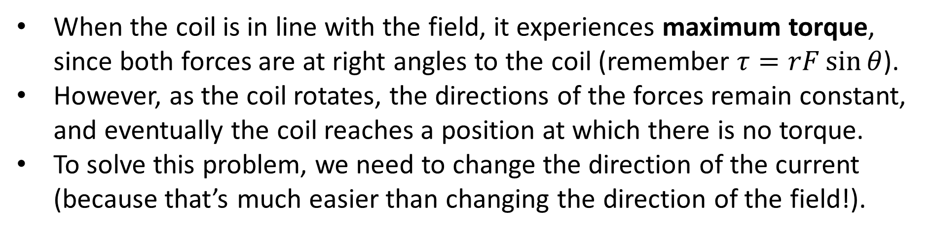
Split Ring Commutators
When the coil is in line with the field, it experiences maximum torque, since both forces are at right angles to the coil (remember $τ=rF\sin{θ}$).
However, as the coil rotates, the directions of the forces remain constant, and eventually the coil reaches a position at which there is no torque.
To solve this problem, we need to change the direction of the current (because that’s much easier than changing the direction of the field!).
Notes:
Lots of questions ask about maximum torque, so keep this first part in mind.

Slide 6
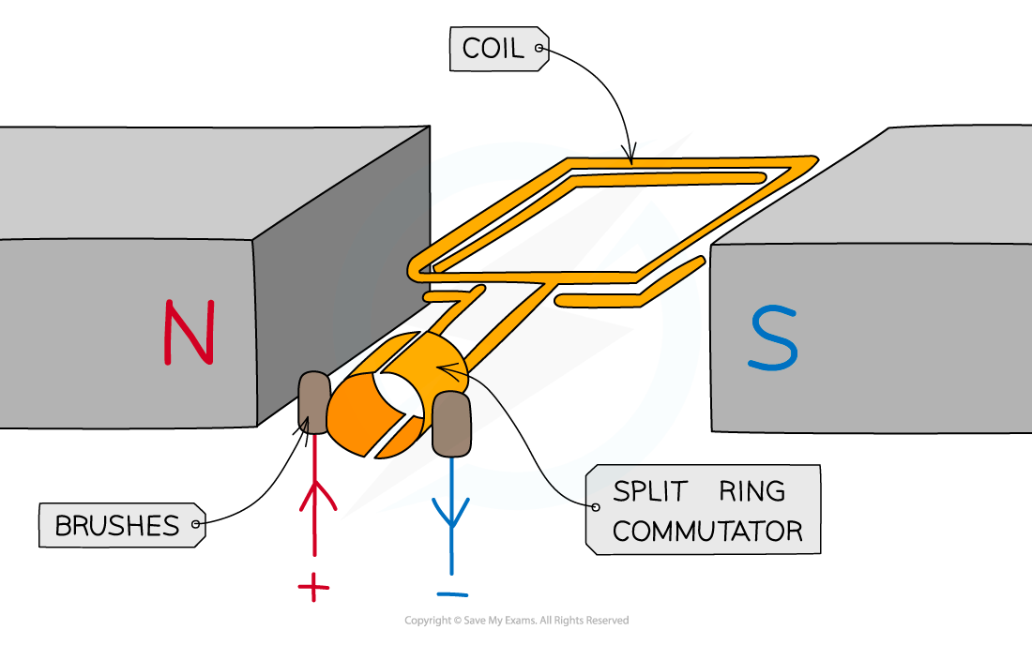
Split Ring Commutators
In a motor, the power supply is not permanently attached to the coil – it makes contact with it through pieces of graphite called brushes.
These brushes touch (brush against) a part of the coil called a split ring commutator – a conductive ring with two gaps in it.
As the coil rotates, the commutator regularly reverses the direction of the current, maintaining the torque on the coil.
Notes:
That’s not actually why they’re called brushes, but it does make it easier to remember what they do!

Slide 7
Split Ring Commutators
Note that the coil briefly has no current flowing through it (during the split / gap), and is carried back into contact with the brushes by its own momentum.
Notes:
In a real motor, the split would be much smaller – it’s exaggerated here to demonstrate the point.

Slide 8
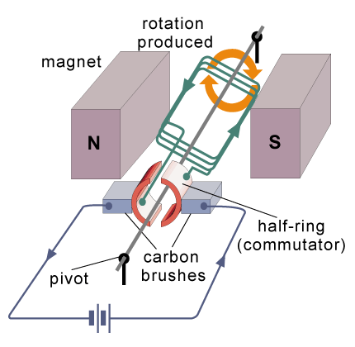
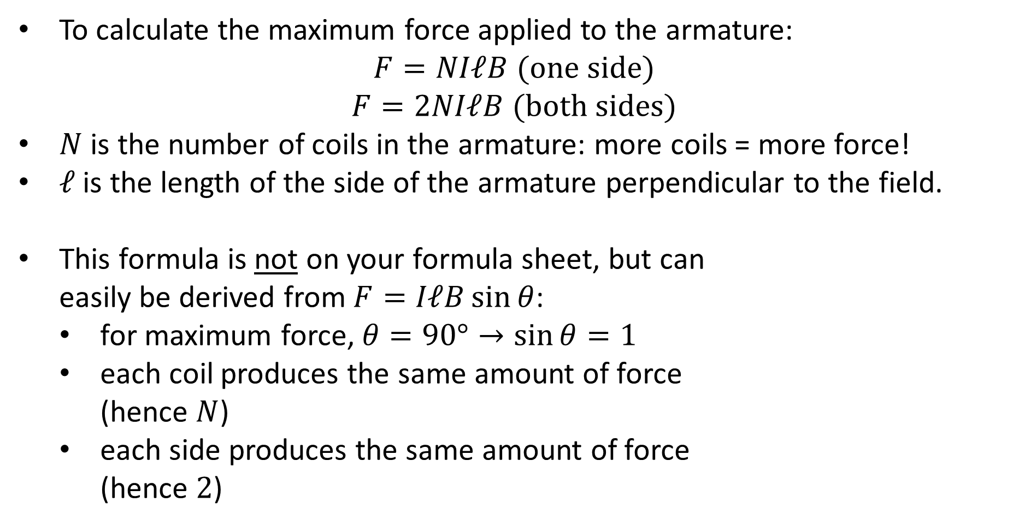
Motor Calculations
To calculate the maximum force applied to the armature:
$$F=NIℓB \text{(}\text{one} \text{side}\text{)}$$
$$F=2NIℓB \text{(}\text{both} \text{sides}\text{)}$$
$N$ is the number of coils in the armature: more coils = more force!
$ℓ$ is the length of the side of the armature perpendicular to the field.
This formula is not on your formula sheet, but can easily be derived from $F=IℓB\sin{θ}$:
for maximum force, $θ=90°→\sin{θ}=1$
each coil produces the same amount of force (hence $N$)
each side produces the same amount of force (hence $2$)

Slide 9
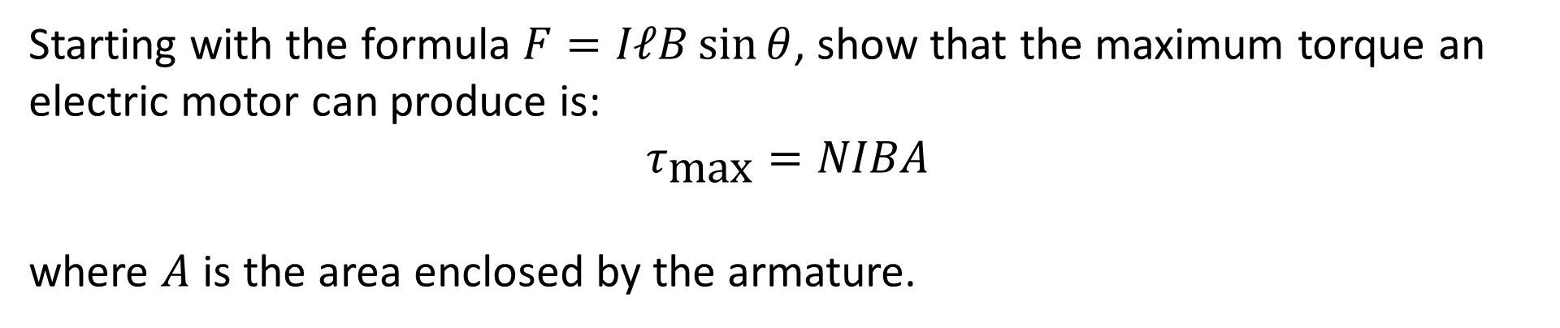
Example #1
Starting with the formula $F=IℓB\sin{θ}$, show that the maximum torque an electric motor can produce is:
$$τ_{\text{max}}=NIBA$$
where $A$ is the area enclosed by the armature.

Slide 10
Example #2
A motor is made up of 20 turns of square coil with a side length of 8 cm and has a current of 425 mA running through it. The external magnetic flux density is 300 mT.
Calculate the force and then torque acting on a single side of the motor when the coil is parallel with the magnetic field.
Calculate the force and then the torque acting on a single side of the motor when the coil is perpendicular with the magnetic field.
Calculate the maximum torque that the motor produces.
Notes:
0.204 N, 8.16 × 10⁻³ N m
0.204 N, 0 N m
1.63 × 10⁻² N m

Slide 11
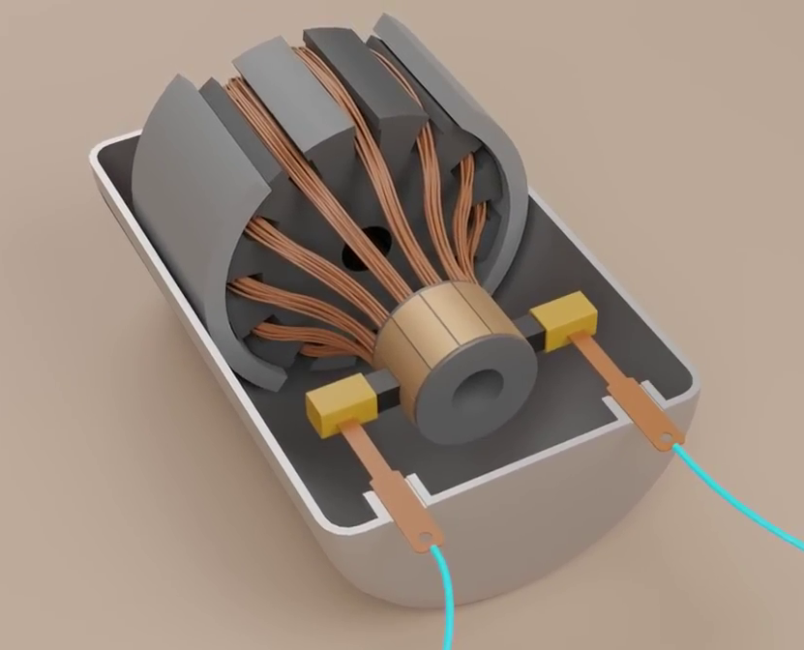
Example #3
Using your understanding of electromagnetism and electric motors, propose at least one way that each of the following improvements to a motor could be achieved:
Increasing the magnetic flux density
Increasing the maximum torque
Achieving a more consistent torque
Notes:
Stronger magnets, soft iron core inside the coil
More coils, more current, larger coils (increase ℓ or r)
Multiple armatures
Image is a frame from an excellent video about DC motors: https://youtu.be/CWulQ1ZSE3c

